Slide 1

Hybrid Core Technical Task

Slide 2
Hybrid Core Technical Task
Dataset and EDA
Text Classification Models
NLP ML Text Classification Models
BERT Text Classification Model
Scikitlearn Multioutput Models
Challenges of Working with very Small Datasets
Conclusion

Slide 3
Dataset and EDA
Dataset consists of 489 rows and 27 column;
'DocumentId',
'EventInstanceId',
'#',
'News Date',
'Source',
'Country',
'Location (LatLng)',
'Locations',
'Headline',
'Abstract',
'First Part',
'Body',
'URL',
'Event Category',
'1st Level Sub Category',
'2nd Level Sub Category',
'3rd Level Sub Category', 'Start Date',
'End Date',
'Actor List',
'Location Info',
'Level of Event',
'Type',
'Topic',
'Aim',
'Unnamed: 25',
'Unnamed: 26']

Slide 4
Dataset and EDA
Missing Values
DocumentId 24
EventInstanceId 24
# 24
News Date 26
Source 26
Country 25
Location (LatLng) 417
Locations 51
Headline 25
Abstract 29
First Part 38
Body 219
URL 47
Event Category 25
1st Level Sub Category 25
2nd Level Sub Category 238
3rd Level Sub Category 384
1st Level Sub Category 25
2nd Level Sub Category 238
3rd Level Sub Category 384
Start Date 186
End Date 370
Actor List 166
Location Info 205
Level of Event 256
Type 286
Topic 314
Aim 349
Unnamed: 25 361
Unnamed: 26 46

Slide 5
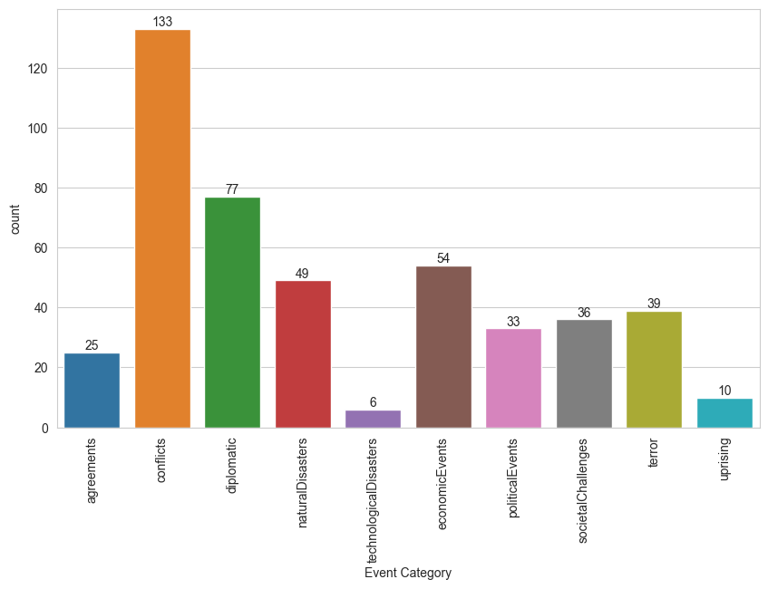
Dataset and EDA
Event Category consists of 10 classes

Slide 6
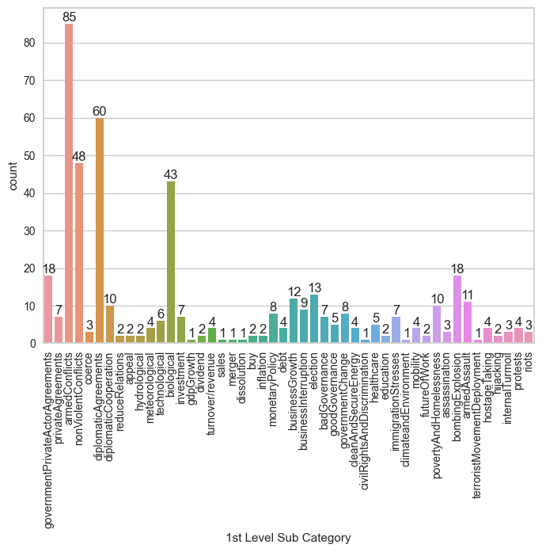
Dataset and EDA
1st Level Sub Cateory consists of 48 classes;

Slide 7
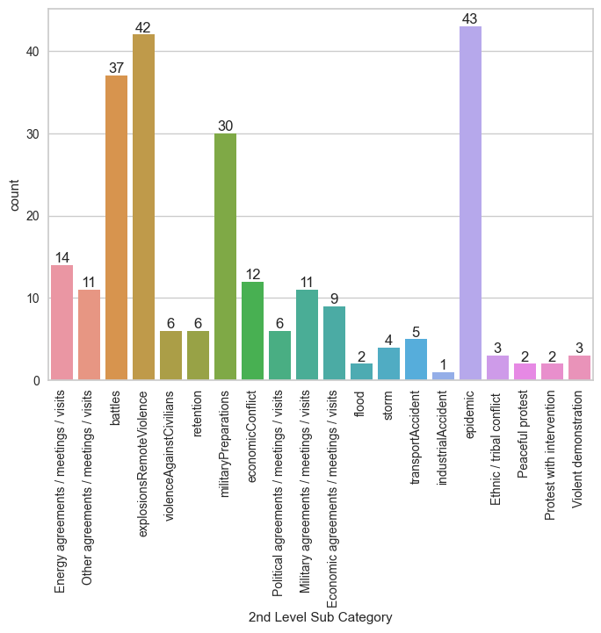
Dataset and EDA
2nd Level Sub Cateory consists of 20 classes;

Slide 8
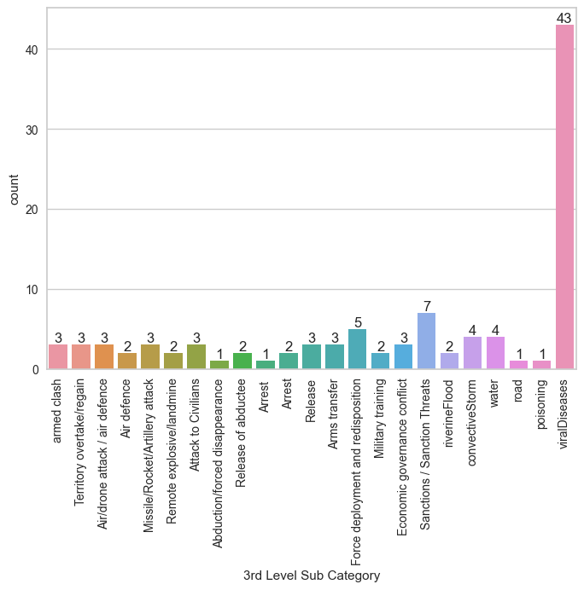
Dataset and EDA
3rd Level Sub Category consists of 23 classes;

Slide 9
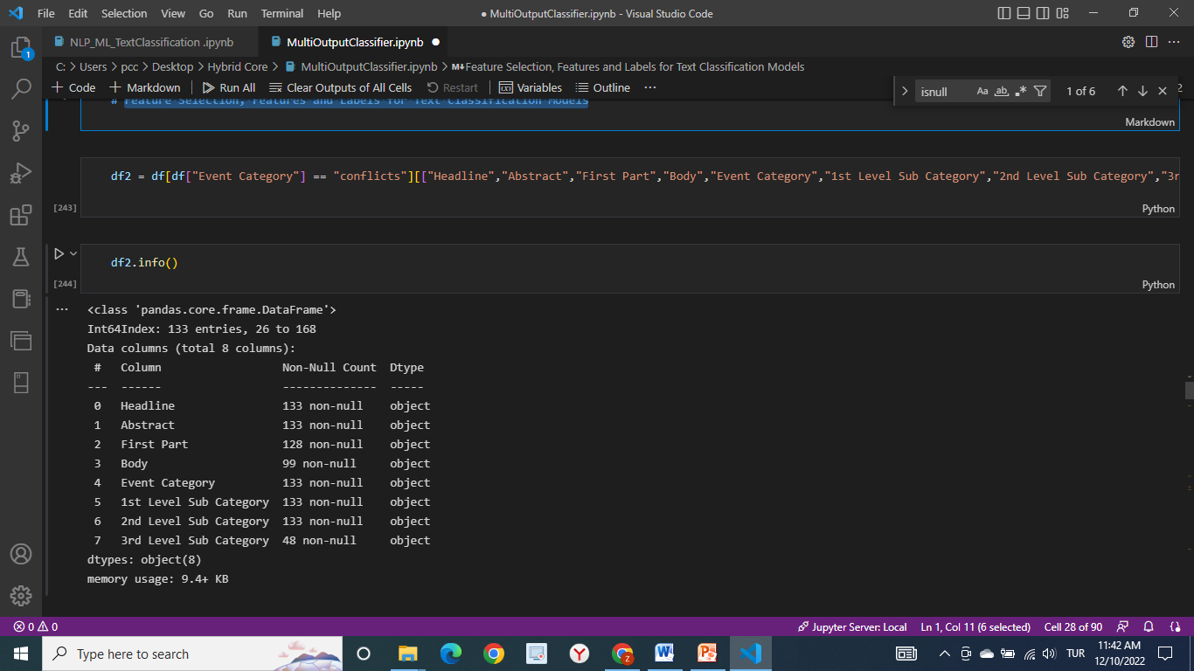
Feature Selection for Text Classification Models
For text classification models, columns below were chosen;

Slide 10
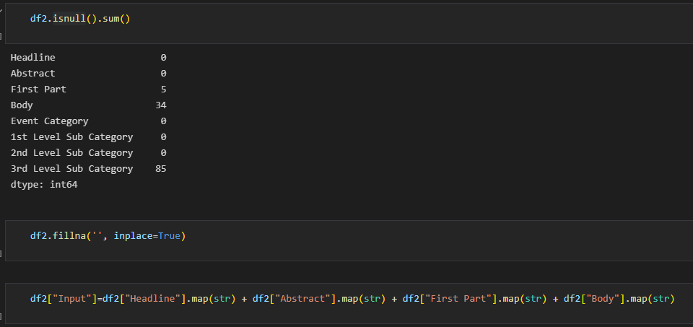
Feature Selection for Text Classification Models
`Headline`, `Abstract`, `First Part` and `Body` Columns are concatanated as `Input` column.
Missing values(NaN) are converted to empty string.
Data is cleaned and lowered for Text Classification (stopwords, punctuation etc.)

Slide 11
Feature Selection for Text Classification Models
Most frequent words for Input data (Word Cloud)

Slide 12
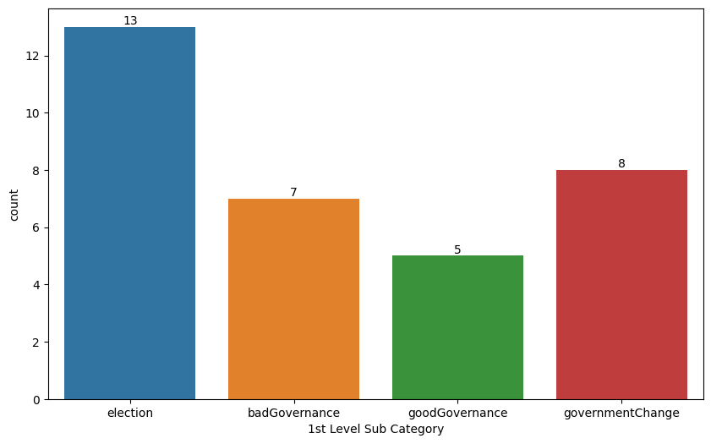
Text Classification Models (NLP ML Text Classisification Models for PoliticalEvent Domain)
PoliticalEvent Domain was chosen for prediction, this domain has only 1st Level Level Sub Category. And 1st Level Sub Category has 4 classes for this domain.

Slide 13
Text Classification Models (NLP ML Text Classisification Models for PoliticalEvent Domain)
For NLP ML Text Classisification, models below were built and comparted.
For vectorization, Count Vectorizer and TF-IDF Vectorizers were used seperately for each model.
Models built and compared;
Naive Bayes
Logistic regression
KNN
SVM
Random Forest
ADA Boost

Slide 14
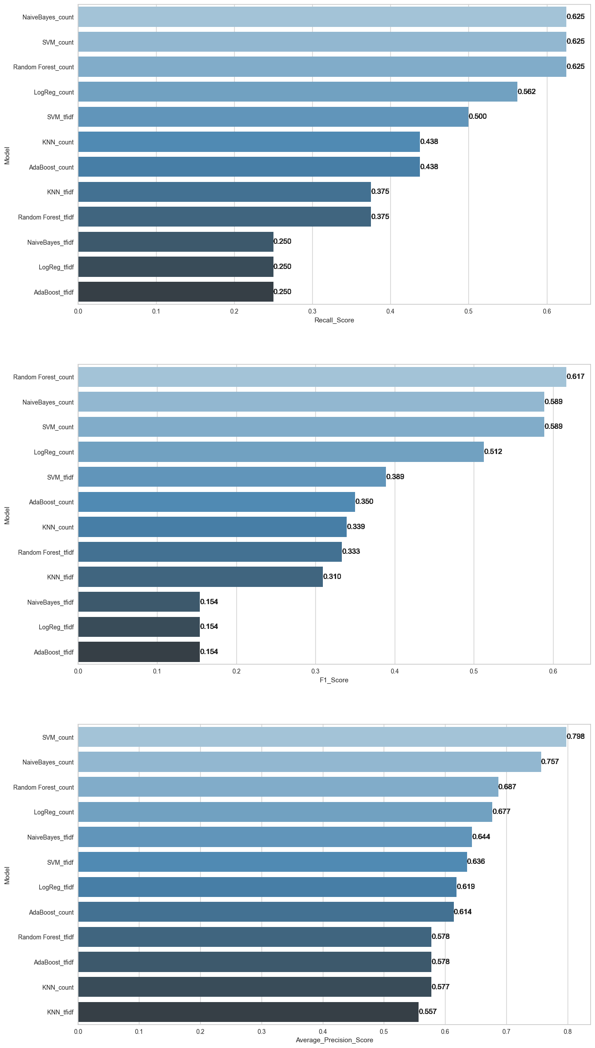
NLP ML Text Classisification Models Comparison
Recall, F1 and Precision Scores were compared.

Slide 15
NLP ML Text Classisification Models Comparison

Slide 16
NLP ML Text Classisification Models Comparison

Slide 17
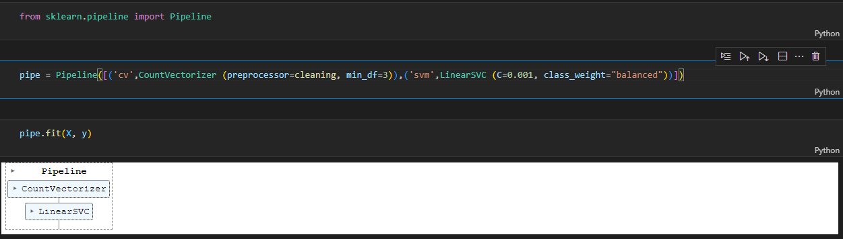
NLP ML Text Classisification Models (Best Model-SVM)
SVM model with count vectorizer was chosen as the best model since it has better Recall, F1 and precision scores.
Pipeline was built for the best model for predicition;

Slide 18
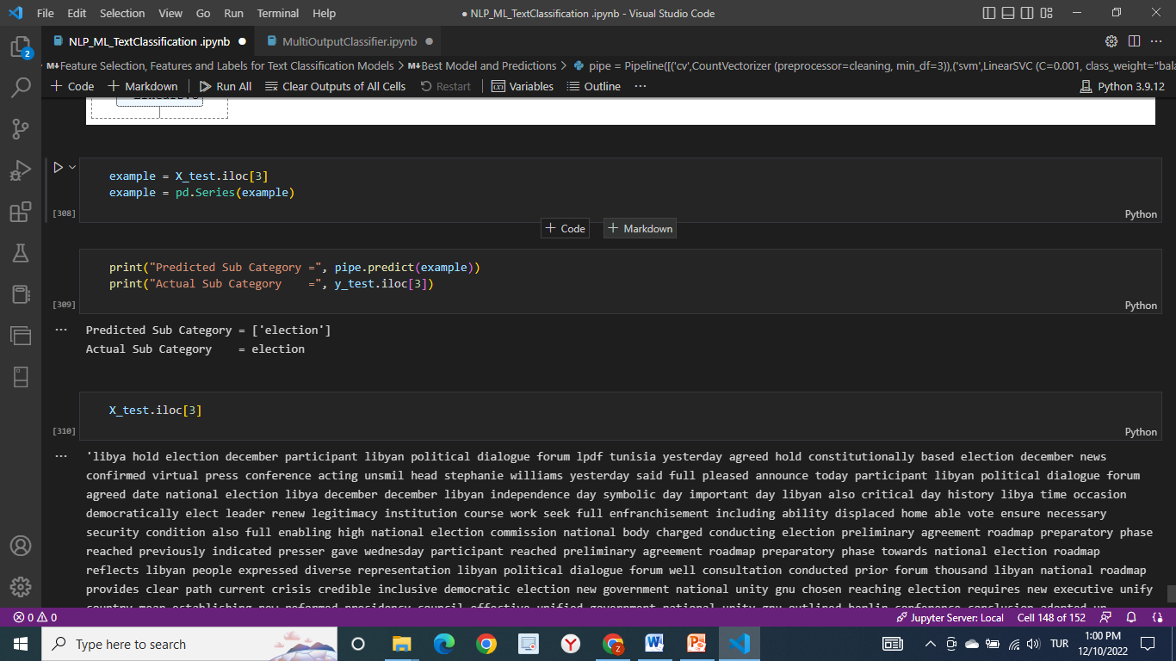
NLP ML Text Classisification Models (Best Model Predicition)
Prediction with test data;

Slide 19
Text Classification Models (BERT Model)
BERT-Bidirectional Encoder Representations from Transformers have been wildly successful on a variety of tasks in NLP (natural language processing).
They compute vector-space representations of natural language that are suitable for use in deep learning models.
The BERT family of models uses the Transformer encoder architecture to process each token of input text in the full context of all tokens before and after, hence the name: Bidirectional Encoder Representations from Transformers.
BERT models are usually pre-trained on a large corpus of text, then fine-tuned for specific tasks.

Slide 20
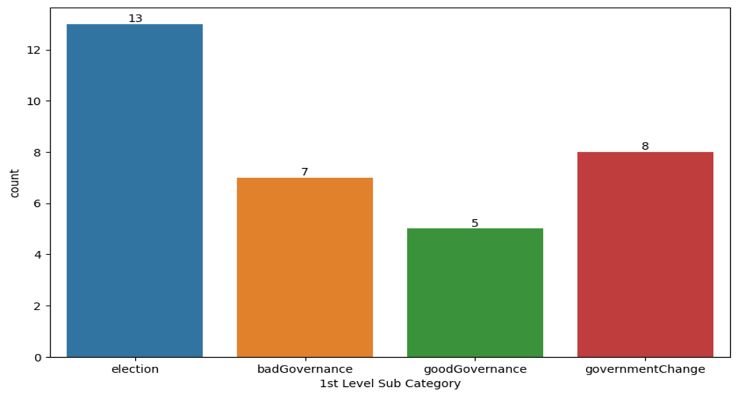
Text Classification Models (BERT Model)
PoliticalEvent Domain was chosen for prediction, this domain has only 1st Level Level Sub Category. And 1st Level Sub Category has 4 classes for this domain.

Slide 21
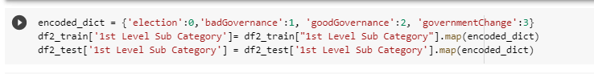
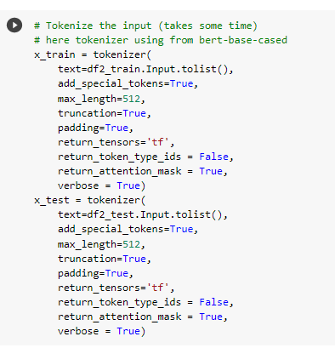
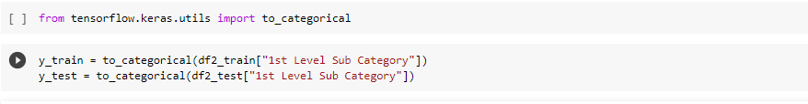
Text Classification Models (BERT Model)
1st Level Sub Category column (Target column) values were converted into categorical values. Then dataset was tokenized with BERT Tokenizer.

Slide 22
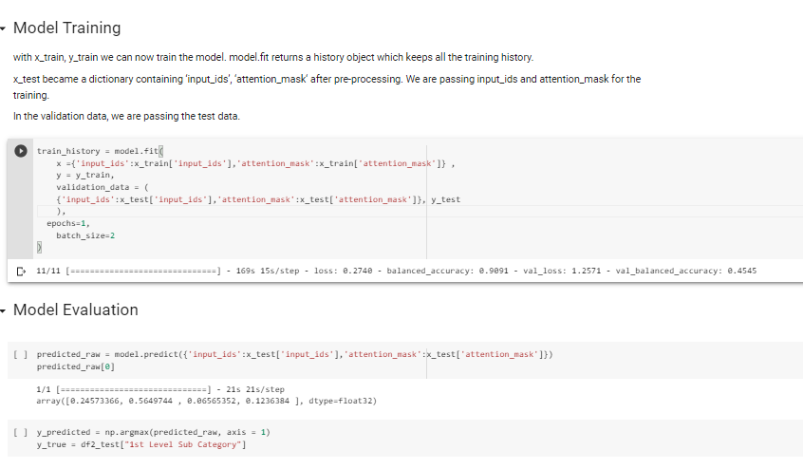
Text Classification Models (BERT Model)
Model Building and Model Evaluation

Slide 23
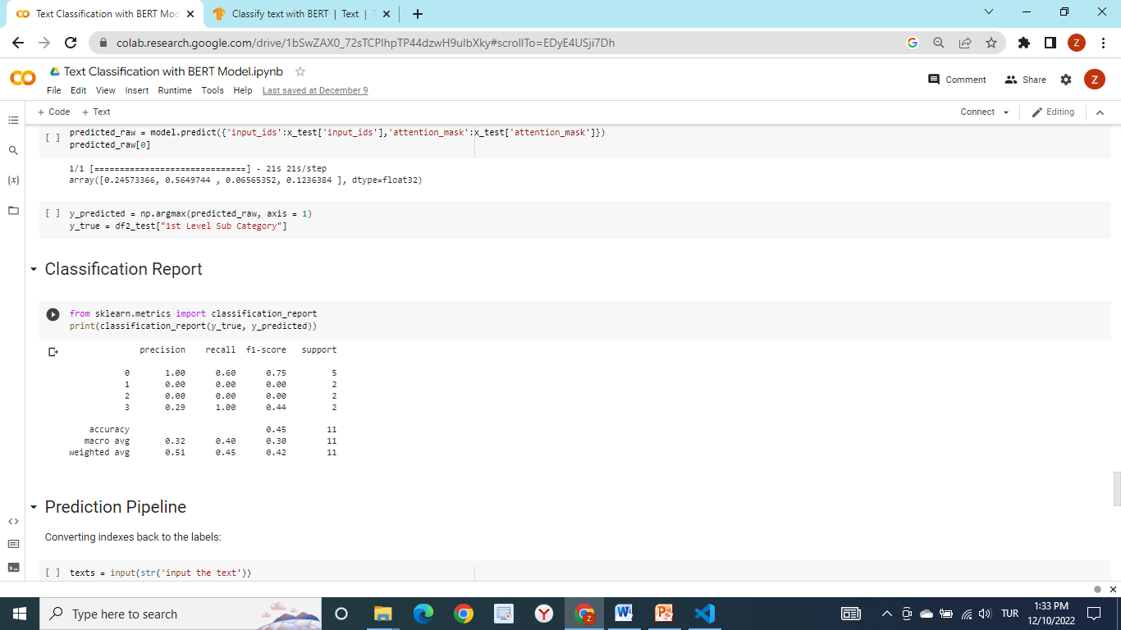
Text Classification Models (BERT Model)

Slide 24
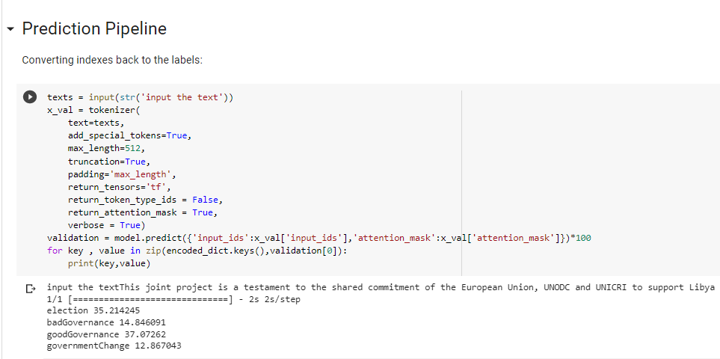
Text Classification Models (BERT Model)
Model gives predicted probability of each class for a given input data.
Example above shows that predicited class is «badGovernance» and acual is «badGovernance»

Slide 25
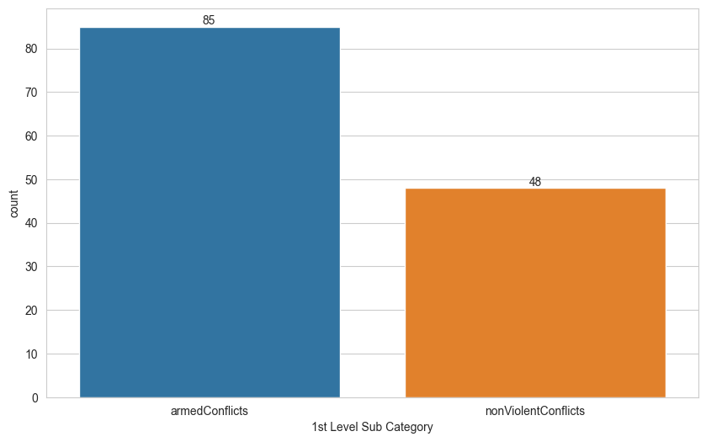
Text Classification Models (Multioutput Models)
Conflicts Column was chosen as domain for multioutput classification models;
1st Level Sub Category for Conflicts domain consists of 2 classes.

Slide 26
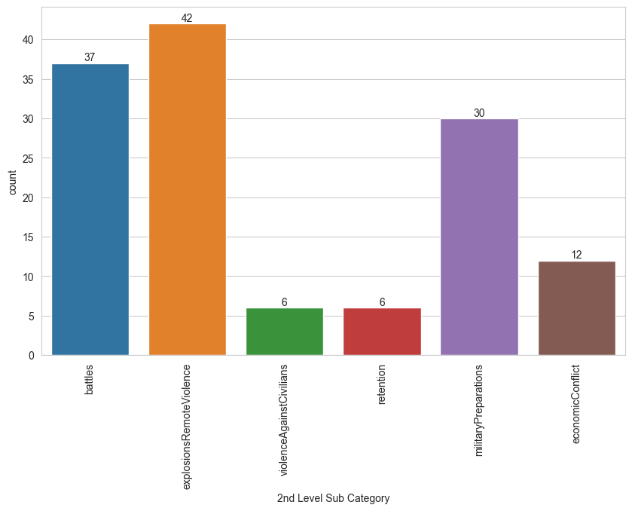
Text Classification Models (Multioutput Models)
2nd Level Sub Cateory for Conflicts domain consists of 6 classes;

Slide 27
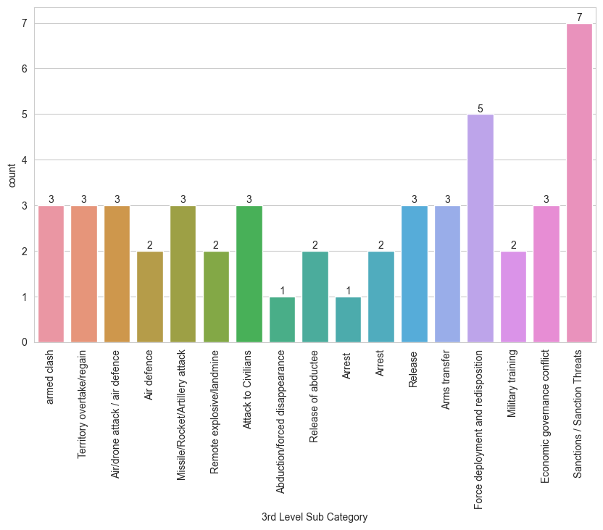
Text Classification Models (Multioutput Models)
3nd Level Sub Category for Conflicts domain consists of 17 classes;

Slide 28
Text Classification Models (Multioutput Models)
`Headline`, `Abstract`, `First Part` and `Body` Columns are concatanated as `Input` column.
Missing values(NaN) are converted to empty string.
Data is cleaned and lowered for Text Classification (stopwords, punctuation etc.)

Slide 29
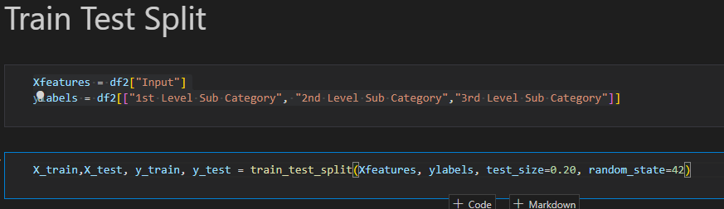
Text Classification Models (Multioutput Models)
3 Different Models were used for multioutput classification;
Multioutput Logistic Regression
Multioutput Kneighbours Classifier
Multioutput Decision Tree Classifier

Slide 30
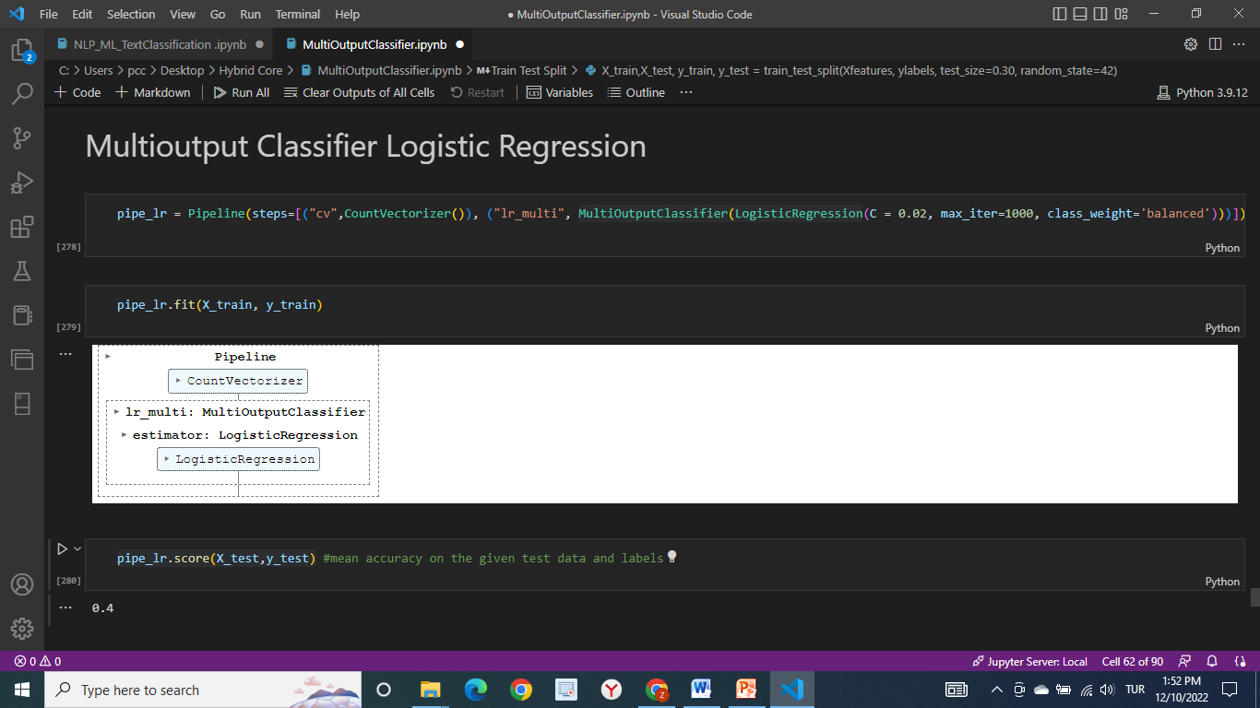
Text Classification Models (Multioutput Models-Logistic Regression)

Slide 31
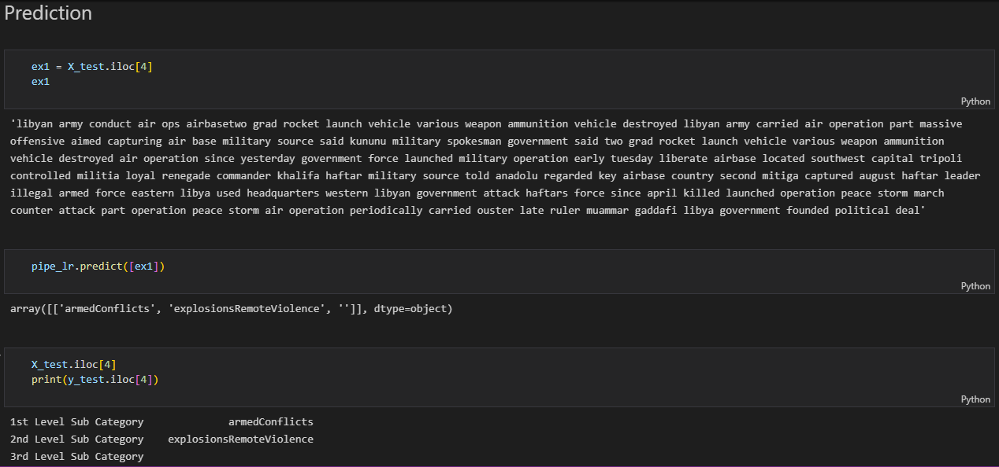
Text Classification Models (Multioutput Models-Logistic Regression)

Slide 32
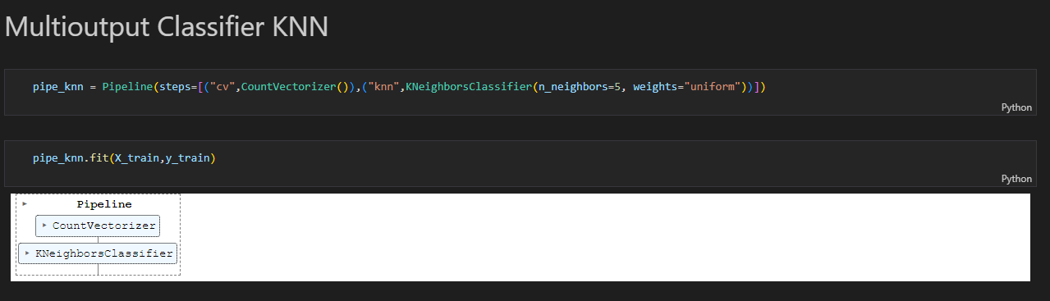
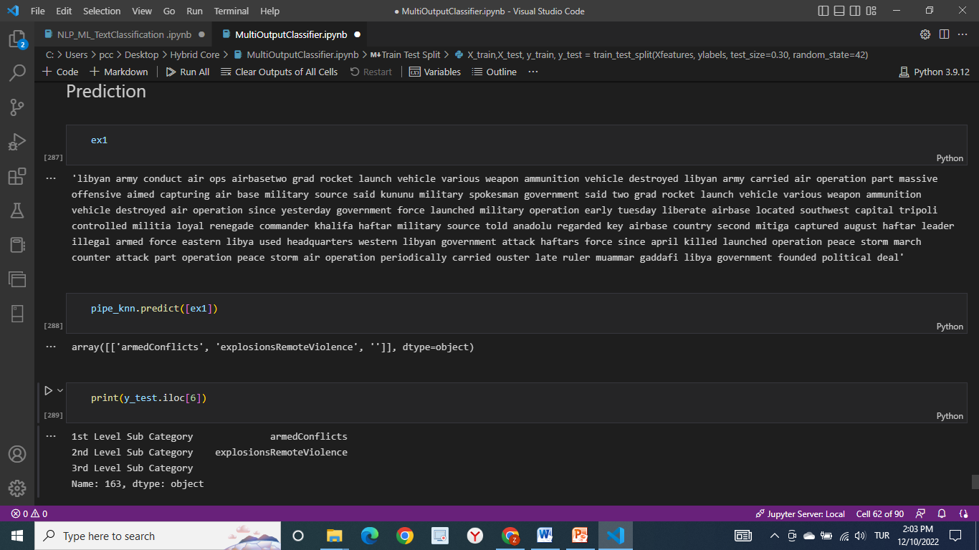
Text Classification Models (Multioutput Models-KNN Classifier)

Slide 33
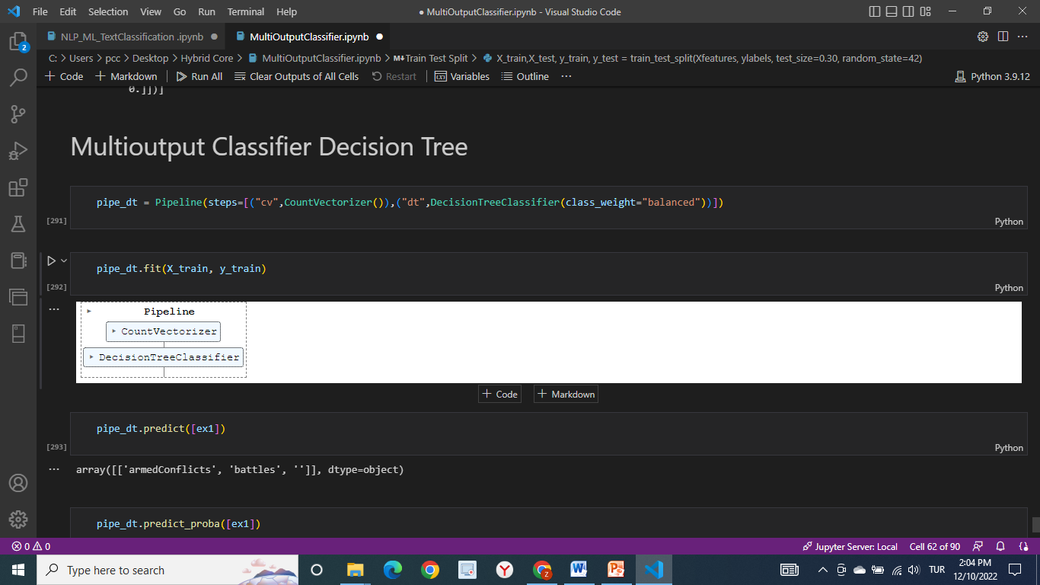
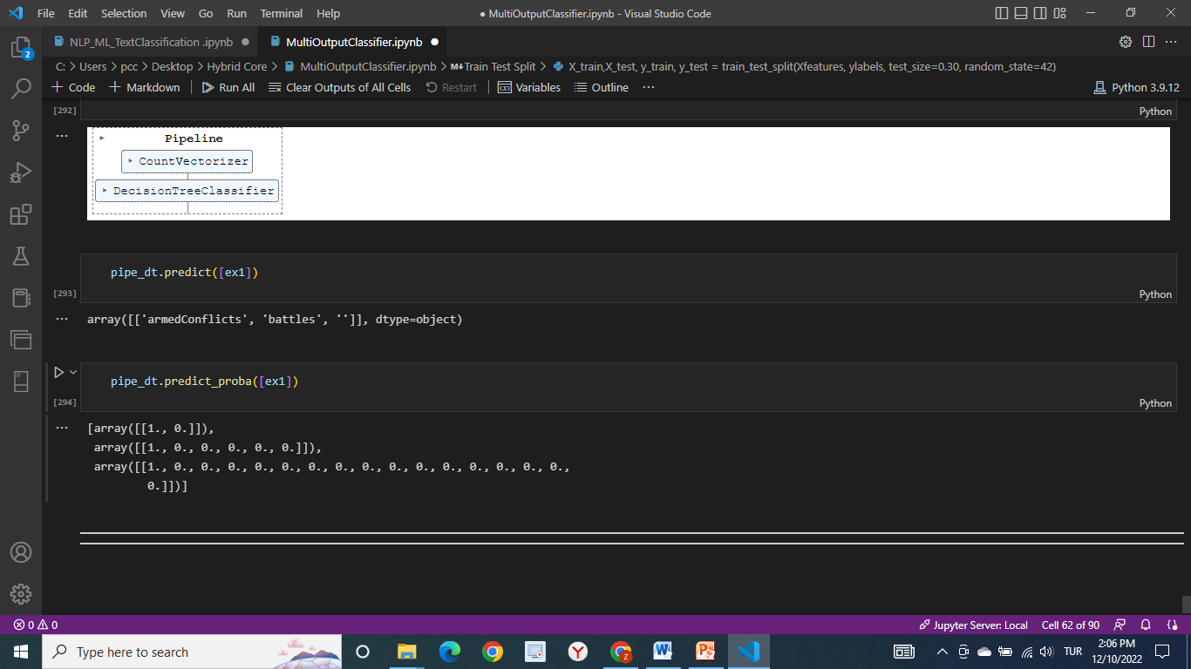
Text Classification Models (Multioutput Models-Decision Tree Classifier)

Slide 34
Challanges of Working with very Small Datasets
Overfitting: When the dataset is very small the classifier has more degrees of freedom to construct the decision boundary. It means that the classifier struggles to generalize with the small amount of data. Mathematically, this means our prediction will have high variance.
Potential Solutions:
Regularization: I tried to use different hyper parameters to get better results and avoid overfitting but for most models it was impossible since the dataset is very small.
Simpler models: I have used Low complexity linear models like Logistic Regression and SVMs. These models perform better as they have smaller degrees of freedom.
High Dimensionality :
If we increase the dimensionality without increasing the number of training samples, the feature space becomes more sparse and the classifier overfits easily. This is a direct result of the curse of dimensionality.
Potential Solution:
Feature Selection: I have removed unusefull features from the dataset to build the models.

Slide 35
Challanges of Working with very Small Datasets
Splitting Data evenly: Test and Train data should have the same distribution so that any improvements on the train set is reflected in the test set.
Potential Solution:
Dataset is imbalanced and stratify or shuffle methods were used. They didn’t work well since the dataset is exteremely small.
SMOTE-Synthetic Minority Oversampling Technique method was also used, it helped to deal with imbalanced data and small dataset. SMOTE resulted same recall performance but lower precision score.

Slide 36
How to choose Test Train Size?
Empirical studies show that the best results are obtained if we use 20-30% of the data for testing, and the remaining 70-80% of the data for training.
It is also important that when working with very small datasets test data should represent all classes in the label data.
I have used 80/20 and 70/30 ratio for this dataset. If the dataset were a larger dataset it would be better to use a larger data for training.

Slide 37
Conclusion
I have used 3 different techniques for text classification on a very small dataset.
ML Models for Text Classification for multiclass prediction
BERT Model for multiclass prediction
Multioutput Models for multiclass-multioutput prediction
SMOTE resulted same recall performance but lower precision score.
Naive Bayes and SVM had better results on a small dataset for classical ML Classifier models
BERT model worked well with a small dataset since It is a pretrained model. But it tends to generalize the output for a small dataset.
Multioutput Classifiers are best for multiclass-multilabel predictions. Decision Tree and KNN for Multioutput Classification don’t support performance metrics. Only Logistic Regression Multioutput Classifier supports accuracy score. Overall they worked well on a small dataset to predict multiclass-multilabel outputs.

